Slide 1
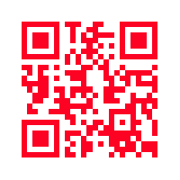

By: Matt Snyder, Morgan Thurow, Kenny Spence
Notes:
All Aspects brought to you by Kenny Spence, Morgan Thurow, and Matt Snyder

Slide 2
Table Of Contents
Written Overview Pg. 3
Floor Plan Pg. 4-7
Sign Copies Pg. 8
Calendar Pg. 9
Visual Check Sheet Pg. 10
Notes:
The table of contents will consists of a written overview on page three with a floor plan on pages four through seven, followed up by sign copies on page eight. There will be a calendar on page nine and a visual check sheet on page ten.

Slide 3
Written Overview
  For the All Aspects promotional plan, we chose the theme “Back to School.” We felt this was a great theme to pick because of the companies that All Aspects is targeting and is big into getting kids ready to go back to school with fresh and cool new looks. To grab the attention of our customers, the colors chosen were a Cherry Red and a Seafoam Green. These colors are great paired together because they are bright and bold and also very complementary toward each other. Not only did we want to get the customers attention with our bold colors but also through an awesome foundation that they can help support. The foundation that was chosen is called “ Kids In Need Foundation,” which is a foundation that supports children who are in need of school supplies and any other necessities. All Aspects has decided that for every order written, we will donate 10 assignment notebooks to the “KINF.” To promote our line we will be at the Venue event in New York City. To get our customers aware of this we will send out direct emails to the buyers who will be in attendance at the event and also through advertising on our Facebook and Instagram. We will be promoting our new line, along with promotions that we have going on at our booth. To show our appreciation for our customers and for new customers visiting our booth, they will have the chance to win something off of our “Wheel of Aspects.” By placing an order, they can spin the wheel and receive drawstring bags, assignment notebooks, key chains, free shipping, or terms of 60 and 90 days. This will be a great way to reel in new and previous customers to see our new line and the great promotions that we have to offer them. Also, to grab buyers attention, we will be placing our “Wheel of Aspects” front and center, along with our signature logo that we chose to create in our new colors for our “Back to School” collection. We think the promotional plan that we created will bring great success to All Aspects and hope that our customers see our hard work and dedication that we have for our company.
Notes:
The written overview is a summarization of our theme, our civic event, how we will advertise, our giveaways and what our signs will look like within the booth.

Slide 4
Floor Plan
Notes:
The booth will measure 14 feet by 12.25 feet. Inside the booth will consist of two shelf hanging systems to display the apparel and accessories. It will also include a sit down desk and two standing tables to write orders on. At the front of the booth there will be the Wheel of Aspects that the buyer can spin if they place an order.

Slide 8
Sign Copies
Notes:
Within our booth we will have four signs total. The first sign is the Wheel of Aspects. The other three will be poster size 22 by 28 inches. These poster signs will be hung eye level, one on each of the three interior walls, and the designs include the eyes and All Aspects logos.

Slide 9
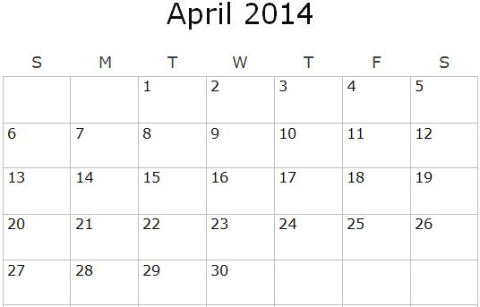
Calendar
Set up booth
Event Day 1
Event Day 2
Event Day 3
Notes:
Wednesday April second we will arrive at the trade show to set up and display merchandise for booth 608. The trade show will go on from Thursday April 3rd through Saturday April 5th and in conclusion of the last day we will take the booth down.

