Slide 1
Alpha Beta Karma
“Social Media Promotion Plan” (March 2014)
Courtney Buscemi Gianna Kneubuehl
Viktoria Scott Mathew Snyder

Slide 2
Table of Contents:
Company mission and vision p.3
SWOT analysis p.4
Promotional objectives and expected results p.5
Calendar timeline for the event p.6
Special event p.7
Sales promotion 1 p.8
Sales promotion 2 p.9
Press release p.10
Conclusion p.11

Slide 3
Company Mission and Vision:
To provide unique, affordable, women’s apparel that allows the consumer to be herself. Where Parisian Market meets So-Ho Boutique, providing both a combination of elegance and edge.
Fashion that won’t break the bank, but will make you feel like a million bucks.

Slide 4
SWOT Analysis:
Strengths: Over a dozen promotional marketing strategies in place (travel guides, hotels, partnerships, etc.) Unique apparel with limited size runs creates a special appeal on all garments. “Once it’s gone, it’s gone.”
Weaknesses: Website content and item availability could be kept more current.
Opportunities: Engage in more marketing activity outside of the community through social media and the website. Keeping website more current with happenings and item availability. Instead of no items in certain categories have items stay listed as “sold out.”
Threats: Tanger Outlet Mall provides consumers with an alternative shopping opportunity consisting of variety and more recognized brand names.

Slide 5
Promotional Objectives and Expected Results:
Increase total number of transactions for the months of April and May. We will track the results by comparing total number of transactions from April/May 2013 to total number of transactions in April/May 2014.
To increase brand awareness on Pinterest by 10% in the month of March. We will track this by the amount of “re pins” from our followers.

Slide 6
Calendar Timeline For Event:
Promotions #1 & #2 will run simultaneously March 1-31
Open House

Slide 7
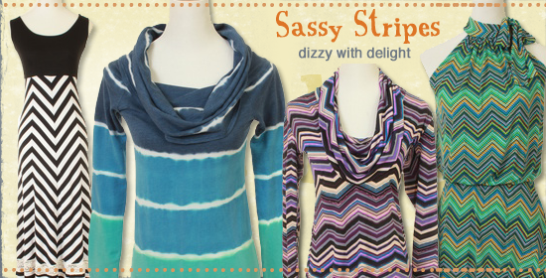
Special Event:
Start of Spring Open House Event
Saturday March 22nd (5-9pm)
Time to clean out your winter closet so come and enjoy the simple elements of Spring Fashion!
Only $15 per ticket (wine and appetizers included)
Located at Alpha Beta Karma
212 Broadway
Wisconsin Dells, WI 53965

Slide 8
Sales Promotion #1:
“Spend $100 or more and receive a 15% off coupon for a future visit.”
Promotion runs March 1-31. Coupons must be redeemed in April or May only.
Alpha Beta Karma 15% off entire purchase (Valid 4/1-5/31 in store only)

Slide 9
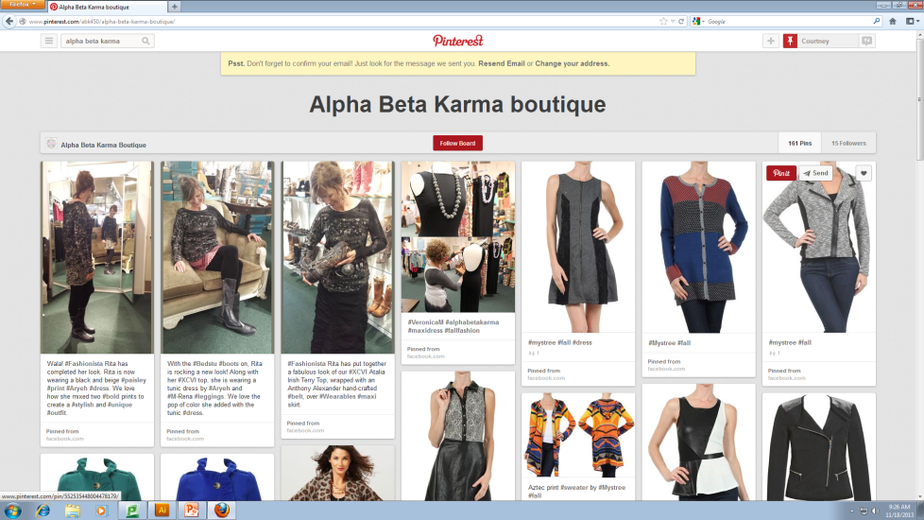
Sales Promotion #2:
“Re-pin” an image on A.B.K. Pinterest page and receive 20% off your in-store purchase. (Must show store associate the “re-pin” on your mobile phone at checkout.)
Promotion runs March 1-31

Slide 10
Press Release:

Slide 11
Conclusion:
Alpha Beta Karma is a unique affordable clothing boutique that provides the latest fashions from high quality brands.
Alpha Beta Karma has an opportunity to drive more sales by leveraging social media and their website.
Promotions have been identified to drive sales volume and recommendations have been made to improve the website.

