Slide 1
Matt, Molly, Courtney
Notes:
This presentation was created by Matt, Molly, and Courtney on the Supreme clothing line.

Slide 2
MISSION AND VISION
Supreme is a worldwide counterculture apparel giant who takes pride in being known for the quality, style, and authenticity of their products. The company strives to create a unique clothing brand that is appealing to their broad target market of urban individuals.
Notes:
In April 1994, Supreme opened its doors in downtown Manhattan and became the home of NYC skate culture. While it started as a downtown institution, Supreme has grown into a worldwide counter-culture apparel giant and is known for its quality, style and authenticity. Over its 20 year history, Supreme has worked with some of our generations most ground-breaking designers, artists, photographers, and musicians- all who have helped continue to define its unique identity and attitude.

Slide 3
SUMMARIZE THE FINDINGS
Newly discovered 3D scanning allows for individuals body's to be photographed and later molded into clay sculptures. This process is very precise as the models dimensions are entirely accurate to their figure.
Notes:
Through the newly discovered technique of 3d scanning, it is made possible to “clone” the body types of any given individual. This process is done in such a precise way that the dimensions of the mannequin are completely accurate to those of the model.

Slide 4
HOW TO APPLY TO SUPREME
A$AP Rocky and Rihanna, the faces of Supreme, are able to be displayed in each free standing store through the use of the 3D scanners.
Notes:
A$AP Rocky and Rihanna represent the faces of Supreme. With the advancement of the 3D scanning, Supreme is able to have these two celebrities, sculpted into extremely accurate mannequins, and displayed in each of their free standing stores.

Slide 5
TEXT QR CODE
Notes:
We created this text based QR code to link to the Supreme homepage. On the website you are able to navigate to the spring/summer 2014 look book, shop online, and indulge in more information on the brand.

Slide 6
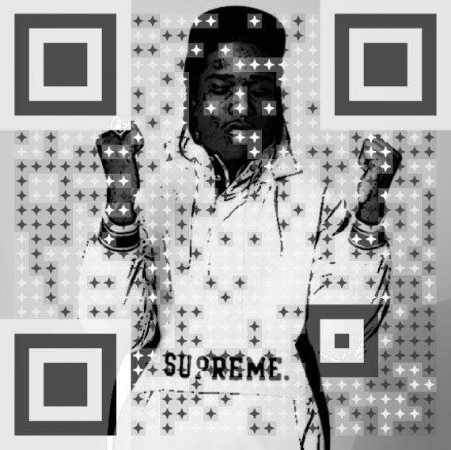
VISUAL QR CODE
Notes:
We have created this visual QR code to link to a music video by A$AP Rocky and Rhianna. These popular artists are sporting Supreme clothing in the “Fashion Killa” video. Listen carefully as they incorporate many well known designers into their song.

