Slide 1
Textiles Forecast Trend Report
Mathew Snyder
September 25, 2013

Slide 2
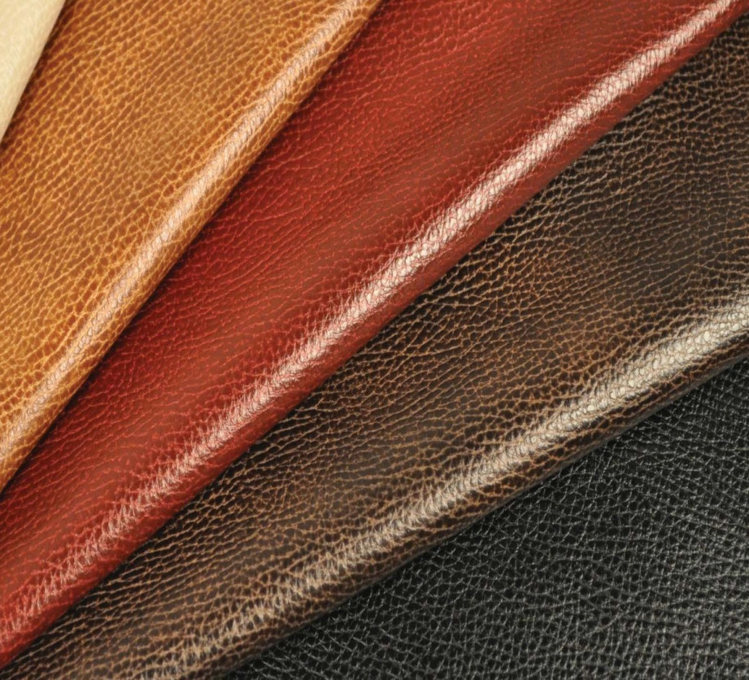
Leather
Textiles Forecast Trend Report
Leather is a durable and flexible material created by the tanning of animal rawhide and skin. It is sold in four forms: Full-grain, top-grain, corrected-grain, and split leather. There are multiple tanning processes but the most common is vegetable-tanned which uses tannins from different vegetable matter and often is supple and brown in color.
Being heavily used in handbags as of late for those trying to bring back the American luxury look.

Slide 3
Cotton Denim
Textiles Forecast Trend Report
Denim is a rugged cotton twill textile, in which the weft passes under two or more warp threads. This twill weaving produces the familiar diagonal ribbing of the fabric. Weft is the term for the thread or yarn which is drawn through the warp yarns to create cloth. Warp is the lengthwise or longitudinal thread in a roll, while weft is the transverse thread.
Most denim today is dyed with synthetic indigo. The cotton will undergo a repetitive sequence of dipping and oxidization.
Can be used for apparel and accessories. Cotton denim jackets have become trendy as of late, and is a classic American look accepted worldwide.

Slide 4
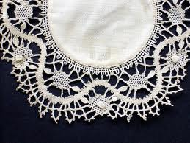
Cotton Lace
Textiles Forecast Trend Report
Lace is an openwork fabric, patterned with open holes in the work, made by machine or by hand.
Lace-making is an ancient craft. A true lace is created when a thread is looped, twisted or braided to other threads independently from a backing fabric.
Tomas Maier is going heavy on the lace when creating new looks for his Bottega Veneta Resort 2014 New York line. His goal was to "create something that's not understandable at first."

Slide 5
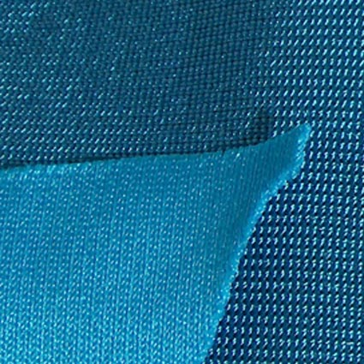
Spandex
Textiles Forecast Trend Report
Spandex or elastane is a synthetic fiber known for its exceptional elasticity. It is strong, but less durable.
Increased use with spandex in combination with other textiles. Gives ease to different garments, making them fit different body types.
Spandex blends can be found in current fashion trends such as leggings, workout apparel, and skateboarding pants.

Slide 6
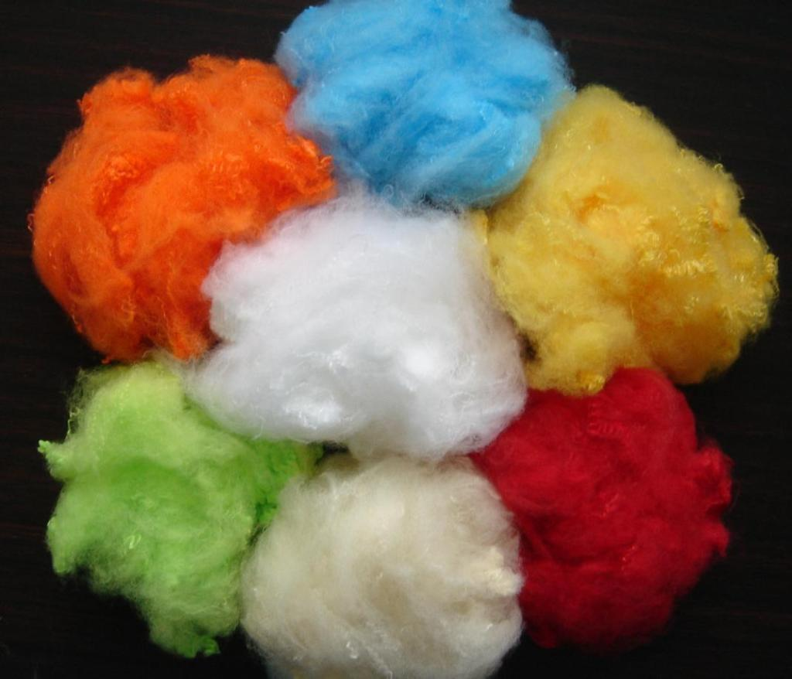
Polyester
Textiles Forecast Trend Report
Polyester is a category of polymers which contain the ester functional group in their main chain. Fabrics woven or knitted from polyester thread or yarn are used extensively in apparel.
Often used in athletic wear and workout apparel for maximum comfort.
As of late polyester also is being used in combination with cotton and rayon for casual clothing with a superior feel and fit.

