Slide 1
Hands on visual display
Mathew Snyder – 05/07/14

Slide 2
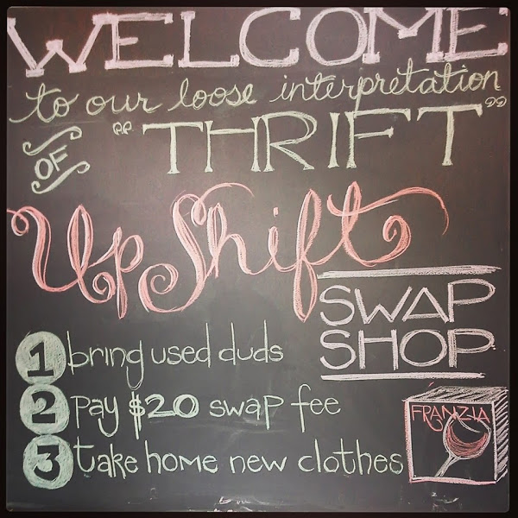
Company Standards (Visual Direction)
Upshift is Madison’s only sustainable clothing
swap boutique. Not only is all of the clothing
100% sustainable, but everything is 100% local
as well. The concept is easy to understand and
ultimately gives clothing multiple lives. Instead of
garments ending up in landfills, they are brought
into the boutique and swapped out for similar
merchandise for one low flat rate. The inventory is
changing daily, which keeps merchandise flowing and
trends fresh. My duty for the day was to dress a
mannequin and offer customers a new style look that
was not on display the day prior.

Slide 3
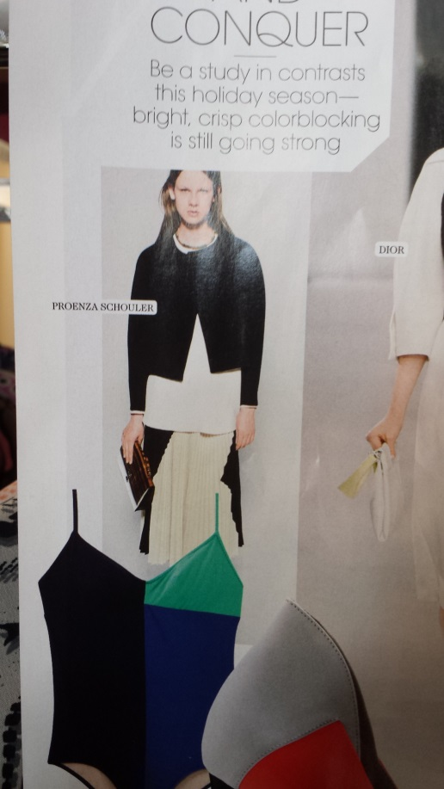
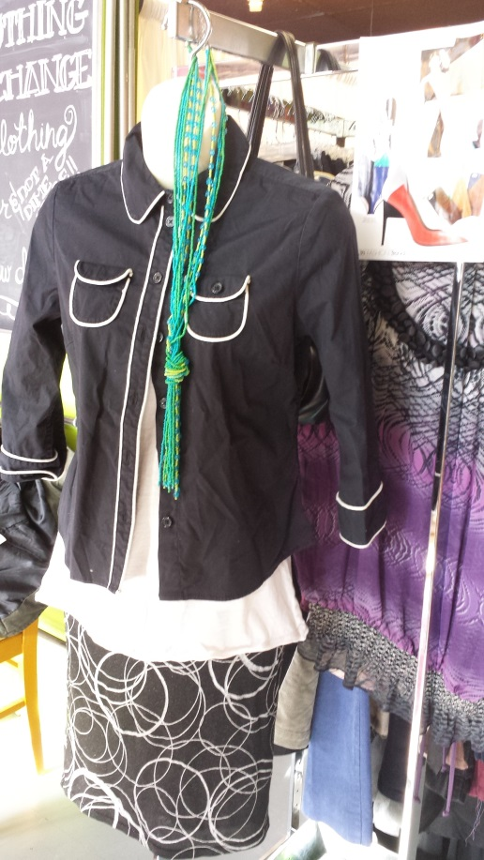
Mannequin Building
Each mannequin starts with a simple
inspiration found inside one of the
fashion publications found within the
store. Not only will this provide a fresh
new look for the display, but also show
the consumer that this display wasn’t
just made up. The styling seen on the
mannequin was influenced by what was
found on the “tear sheet.” Once a tear
sheet was picked, I went through the
boutique looking for garments and
accessories that were as similar as
possible to what was shown on the tear
sheet. Once the mannequin was styled,
the tear sheet was then hung next to
the mannequin for reference.

Slide 4
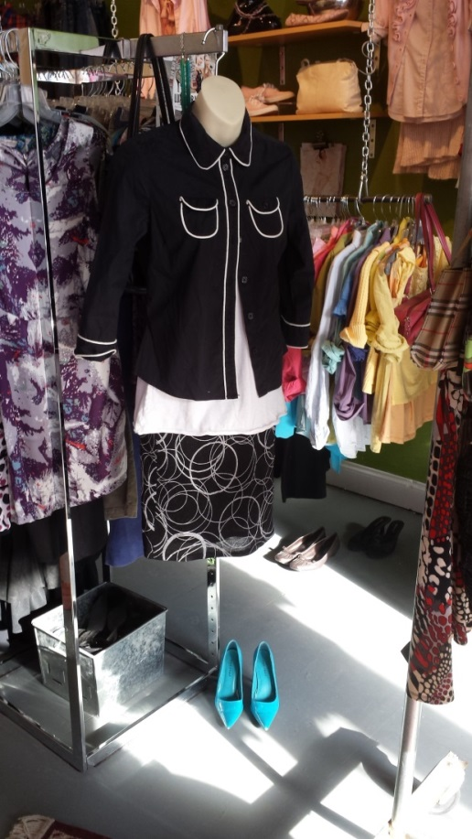
Fashion Coordination
This specific mannequin serves multiple
purposes. Not only does it show how
certain pieces play a small role in forming
a whole outfit, but it also gives the
consumer a new way to style certain
pieces with other pieces. The shopper
may look at this display and like the entire
outfit or she might only like a certain
piece or two, but it at least gives the
shopper an idea as to how pieces look
next to one another. I tried to style this
mannequin as closely as possible to the
tear sheet I choose. I was going for a
decorative neutrals look which consisted
of predominant black and whites with
character. The outfit flows from top to
bottom as looks very similar to the style
shown in the tear sheet. I finished this
outfit off with two accessories. Aqua
pumps gave the outfit a nice pop and looks
great with the aqua micro-beaded necklace.

Slide 5
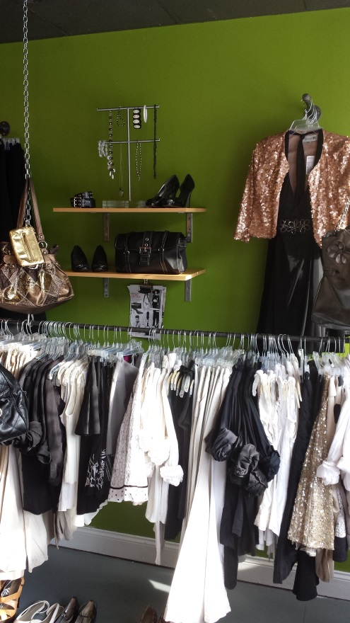
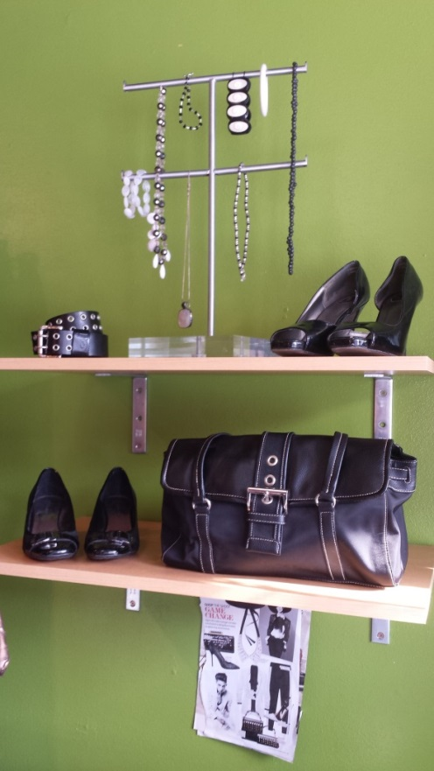
Merchandise Relation
The other display I styled was a
two-shelved wall system that
featured a diverse collection of
accessories. This display was
located just to the right of my
mannequin and gave the shopper
other accessory ideas and how they
could be paired with my outfit for the
day. If the shopper didn’t want the
bold look of aqua accessories, I made
neutral colored accessories easily
available to match the look they
desired. Similar to the mannequins,
the inspiration for my accessories
display was found on a tear sheet in
Elle Fashion Magazine.

Slide 6
Silent Sellers
The mannequins and displays found within
Upshift are an effective and powerful silent
selling tool. They offer a full look from top to
bottom for the shopper. Multiple mannequins
are on display throughout the boutique to
offer the shoppers fresh and new looks without
having to sort through all the racks of clothing.
This makes the whole process extremely easy
for the shopper. It is not uncommon to redress
the same mannequin multiple times during the
day at Upshift. Garments and accessories are
literally taken off of the mannequin and go
home with the shopper. Some consumers
solely shop off of the displayed mannequins.

